Slide 1
Nicole Fiamingo’s Presentation
MKT 730 – Marketing Research February 17, 2011

Slide 2
Dell Printer: “The New Kid On The Block”
http://www.youtube.com/watch?v=42mNRePWIME

Slide 3
Chapter 3
Research Design
Notes:
Research Design – is a framework or blueprint for conducting the marketing research project. It details the procedures necessary for obtaining the information needed to structure or solve the marketing research problem.

Slide 4

Marketing Research Proposal
Executive Summary
Background
Problem Definition
Approach to the problem
Research Design
Fieldwork/ Data Collection
Data Analysis
Reporting
Cost and Time
Appendices

Slide 5
What the Research Design Includes
Define the information needed
Design the exploratory, descriptive, and/or causal phases of the research
Specify the measurement and scaling procedures
Construct and pretest a questionnaire/ data collection
Specify the sampling process and sample size
Develop a plan of data analysis

Slide 6
Research Design
Exploratory Research
Conclusive Research
Descriptive Research
Causal Research
Cross -Sectional
Longitudinal
Single Cross-Sectional
Multiple Cross-Sectional
Notes:
Exploratory Research- is used to provide insight into, and an understanding of, the problem confronting the researcher.
- Used when you must define the problem more precisely, identify relevant course of action, or gain additional insights before an approach can be developed.
1. Survey of experts
2. Pilot survey
3. Case studies
4. Secondary data analyzed in a qualitative way
5. Qualitative research
Conclusive Research- is typically more formal and structured that exploratory research.
-Based on large, representative samples, and the data obtained are subjected to quantitative analysis

Slide 7
Exploratory Vs. Conclusive Research
 | Exploratory | Conclusive
Objective: | To provide insights and understanding | To test specific hypothesis and examine relations
Characteristics: | Information needed is defined loosely | Information needed is clearly defined
Findings/Results: | Tentative Generally followed by conclusive research | Conclusive
Notes:
-When little information is known about the problem situation, it is desirable to begin with exploratory research
-Exploratory research is the usually initial step in the overall design framework
-However, it is not necessary to begin every research design with exploratory research. It depends on the precision of the research problem

Slide 8
Research Design Definitions
Descriptive Research- is used to describe something usually market characteristics or functions
  Determine the degree to which marketing variables are associated
Causal Research- is used to obtain evidence of cause-and-effect relationships

Slide 9
Research Design Definitions Continued
Cross-Sectional Research- involves the collection of information from any given sample of population
    Single Cross-Sectional- only one sample of respondents is drawn from the target population
    Multiple Cross-Sectional- there are two or more samples of respondents
Longitudinal Designs- a fixed sample of population elements is measured repeatedly on the same variables
Notes:
Panel Disadvantages:
1. Refusal to cooperate
2. Mortality
3. Payment

Slide 10
Total Error
Random Sampling Error
Non-sampling Error
Response Error
Non-response Error
Researcher Errors
Interviewer Errors
Respondent Errors
Example
Measurement Error
Questioning Error
Unwillingness Error
Notes:
*Random Sampling Error- occurs because the particular sample selected is an imperfect representation of the population of interest
*Non-Sampling Error- can be attributed to sources other than sampling, may be random or nonrandom
*For further information refer to pages 85-87

Slide 11

Class Discussion Review
Kelly’s Triad = Why
Identifying the key Benefits
Advertising the Value

Slide 12
Chapters 1 and 2 Review
Decision Problem
The current management decision problem facing dell is what should be done to improve and keep a good market share in the personal computer industry, while still expanding into the retail printer market?
Research Problem
Determine customer choice criteria when purchasing a printer or PC
What are our competitors’ offerings in regards to the printer/PC industry
Target Market (Demographics, etc.)

Slide 13
Dell Running Case
How can Dell make use of exploratory research to understand how household consumers buy personal computers and related equipment?
Describe one way in which Dell can make use of descriptive research?
Describe one way in which Dell can make use of causal research?
Dell would like to determine consumer response to a new lightweight tablet PC that is has developed. What research design would you recommend?
Notes:
*Exploratory Research- often relies on secondary research
-Focus groups
-Literature search
-Experience survey
-Analysis of selected cases
Question 4, revert back to slide #5 for help.
*Descriptive Research- the “what is” approach
-What is the best way to enter into the current printer industry?
-Survey
-Interviews
-Observations
-Portfolios
*Causal Research- Cause-and-effect relationships
-Laboratory, field, and test marketing
-Chapter 7 covers causal research more in depth

Slide 14
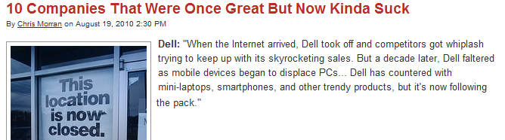
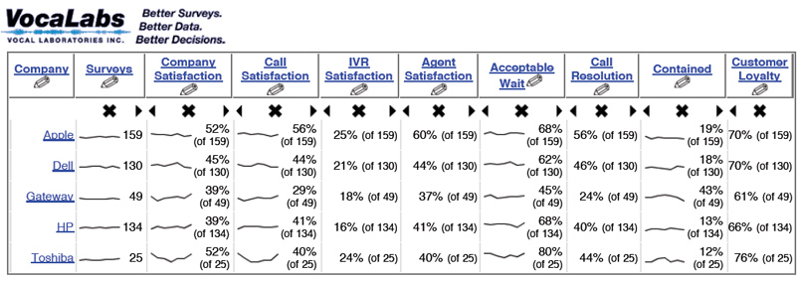

Slide 15
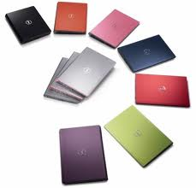
Class Discussion
How should Dell go about developing their Research Design?

Slide 16
Chapter 4
Exploratory Research Design
Secondary Data
Notes:
Research Design – is a framework or blueprint for conducting the marketing research project. It details the procedures necessary for obtaining the information needed to structure or solve the marketing research problem.

Slide 17
Step 1: Problem Definition
Step 2: Approach to the Problem
Step 3: Research Design
Secondary Data
Primary Data
Internal
External
Chapter 5
Computerized Database
Syndicated Services
Database Marketing
Published Materials

Slide 18
Dell Running Case
Search the internet to find information on the latest U.S market share of Dell and other PC marketers.
Search the Internet to obtain information on Dell’s marketing strategy. Do you agree with Dell’s marketing strategy? Why or why not?
Visit the U.S Census Bureau at www.census.gov. As Dell seeks to increase its penetration of U.S households, what information available from the U.S Census Bureau is helpful?
What information available from syndicated firms would be useful to Dell as it seeks to increase its penetration of U.S households?
Notes:
*Syndicated Services- also referred to as syndicated sources, are companies that collect and sell common pools of data of known commercial value, designed to serve information needs.
*Question #1, review slide #17 and #18

Slide 19
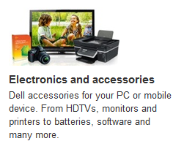
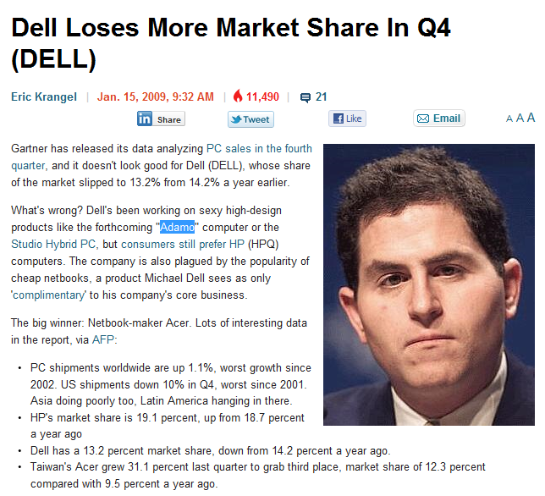
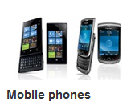
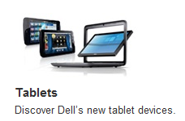
http://www.businessinsider.com/2009/1/dell-losing-market-share-in-anemic-pc-market-dell

Slide 20
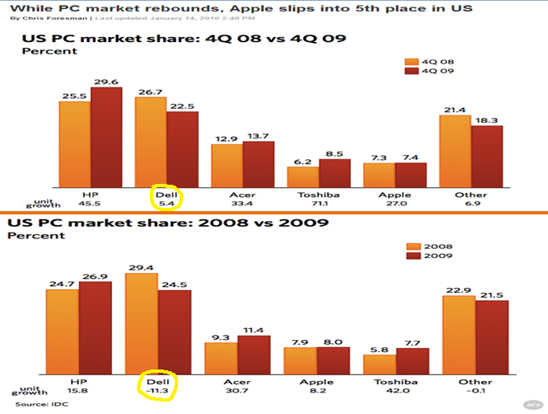
Notes:
http://arstechnica.com/hardware/news/2010/01/while-pc-market-rebounds-apple-slips-into-5th-place-in-us.ars

Slide 21
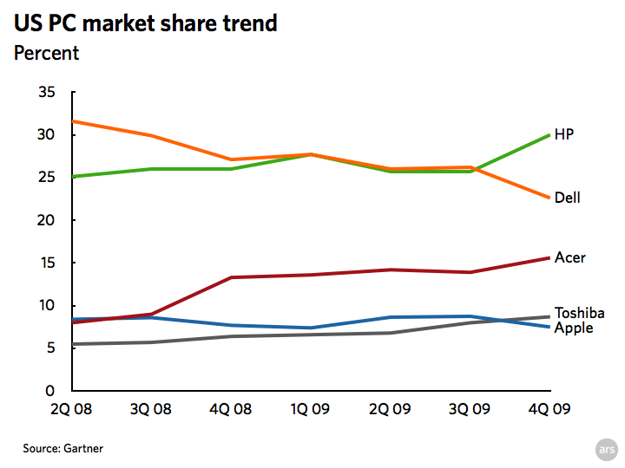
Notes:
http://arstechnica.com/hardware/news/2010/01/while-pc-market-rebounds-apple-slips-into-5th-place-in-us.ars

Slide 22
Dell Running Case
Search the internet to find information on the latest U.S market share of Dell and other PC marketers.
Search the Internet to obtain information on Dell’s marketing strategy. Do you agree with Dell’s marketing strategy? Why or why not?
Visit the U.S Census Bureau at www.census.gov. As Dell seeks to increase its penetration of U.S households, what information available from the U.S Census Bureau is helpful?
What information available from syndicated firms would be useful to Dell as it seeks to increase its penetration of U.S households?
Notes:
*Syndicated Services- also referred to as syndicated sources, are companies that collect and sell common pools of data of known commercial value, designed to serve information needs.
*Question #1, review slide #17 and #18

Slide 23
Dell’s Current Marketing Strategy
"Dell is committed to delivering new dimensions in entertainment, mobility and gaming and is leading the industry in advancing new technologies like 4G solutions and 3D-capable laptops to provide the best entertainment and mobile experiences ever imagined," said Steve Felice, president of Dell's Consumer, Small and Medium Business unit,
In support of the company's "Power To Do More" brand positioning, Dell recently introduced its first-ever Consumer marketing campaign, "You Can Tell It's Dell." "The Power To Do More" captures Dell's belief that technology serves an important purpose in helping every one of our customers -- from large enterprises to public institutions, specialized technology services clients, small and medium-sized business and consumers -- achieve success. At its essence, Dell is focused on helping customers do more and putting their needs first. "You Can Tell It's Dell" builds on powerful foundation by emphasizing the Dell difference through the experiences of buying, owning and using Dell to create a unique and powerful experience for every customer.
"You Can Tell It's Dell" supports the value and relevance of Dell's brand in the context of the consumer experience. Since the campaign's introduction in November, Paul-Henri Ferrand, the chief marketing officer for the company's CSMB division, said that the campaign's 14,000 ads have generated billions of impressions worldwide.
http://www.tweaktown.com/pressrelease/4844/dell_delivers_the_ultimate_in_mobility_entertainment_and_gaming_for_every_stage_of_your_life/

Slide 24
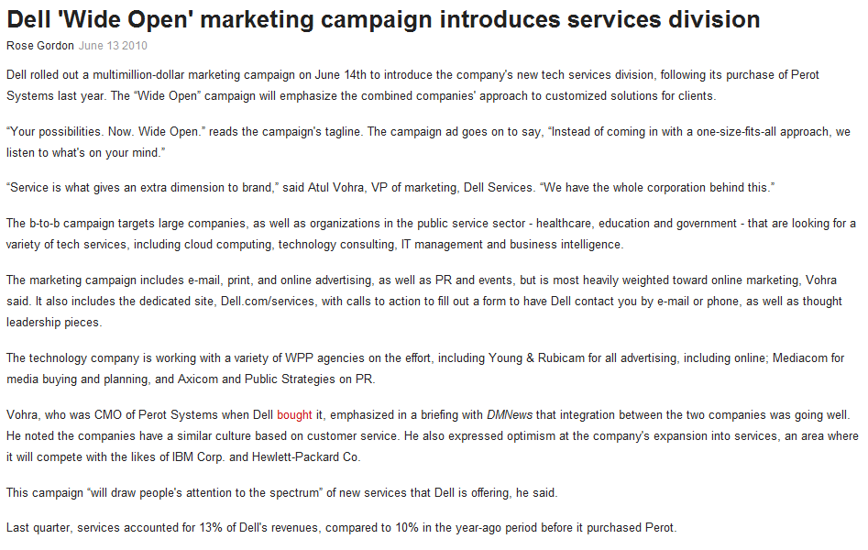
Published June 13, 2010
http://www.dmnews.com/dell-wide-open-marketing-campaign-introduces-services-division/printarticle/172266/
Notes:
http://www.dell.com/content/topics/global.aspx/about_dell/media/multimedia/video_player?c=us&l=en

Slide 25
Chapter 5
Exploratory Research Design
Qualitative Research
Notes:
Research Design – is a framework or blueprint for conducting the marketing research project. It details the procedures necessary for obtaining the information needed to structure or solve the marketing research problem.

Slide 26
Step 1: Problem Definition
Step 2: Approach to the Problem
Step 2: Approach to the Problem
Step 3: Research Design
Secondary Data
Primary Data
Chapter 4
Qualitative
Quantitative
Survey Data
Observation Data
Experimental Data

Slide 27
Qualitative Vs. Quantitative
 | Qualitative Research | Quantitative Research
Objective: | To gain a qualitative understanding of the underlying reasons and motivations | To quantify the data and generalize the results from the sample to the population of interest
Sample: | Small # of non-representative cases | Large # of representative cases
Data Collection: | Unstructured | Structured
Data Analysis: | Non-statistical | Statistical
Outcome: | Develop an initial understanding | Recommend a final course of action
Notes:
http://www.fhi.org/nr/rdonlyres/etl7vogszehu5s4stpzb3tyqlpp7rojv4waq37elpbyei3tgmc4ty6dunbccfzxtaj2rvbaubzmz4f/overview1.pdf

Slide 28
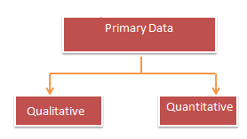
Qualitative Research Procedures
Direct
(Non-disguised)
Indirect
(Disguised)
Projective Techniques
Focus Groups
Depth Interviews
Association
Completion
Construction
Expressive
Notes:
*Expressive is what we referred to in our class discussion as the “role play” technique.

Slide 29
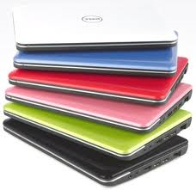
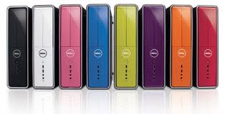
Analysis of Qualitative Data
Data Reduction
Data Display
Conclusion Drawing & Verification

Slide 30

Class Discussion Review
Completion Test
Role Playing Target Market
Association Test
Notes:
*Completion Test- we spoke of showing our audience a picture of 2 women in the supermarket.
*Role playing – we mentioned this method was used to understand the attitudes of our audience
*Association Test- we mentioned McDonald’s, “I’m lovin’ it”

Slide 31
Dell Running Case
In gaining an understanding of the consumer decision-making process for personal computer purchases, would focus groups or depth interviews be more useful? Explain.
Develop a focus group discussion guide for understanding the consumer decision-making process for personal computer purchases.
Notes:
*Focus Group Discussion Guide- please review slide #33
*Projective technique- is an unstructured, indirect form of questioning that encourages respondents to project their underlying motivations, beliefs, attitudes, or feelings regarding the issues of concern.
1. Association
2.Completion
3.Construction
4.Expressive / “Role playing”

Slide 32
Procedure for Planning and Conducting Focus Groups
Determine the objectives of the marketing research project and define the problem
Specify the objectives of qualitative research
State the objectives/questions to be answered by focus groups
Write a screening questionnaire
Develop a moderator’s outline
Conduct the focus group interview
Review tapes and analyze the data
Summarize the findings and plan follow-up research or action

Slide 33

Focus Group Discussion Guide for Dell
Preamble
Thanks and welcome
Refreshments
Questions or concerns?
Intros and Warm-Up
Introductions
Experiences with PCS and Printers
PC Usage
I’d like to understand a bit about how you typically use your PC
(business, personal, etc)
How many hours do you typically spend on your PC per week?
What are the most common program you run on your PC?
Past Printer Purchases
Past Printer Selection Process
Thinking first only about how you went about choosing your printer,
not any features you wanted, how did you go about choosing one?
Past Printer Criteria
What exactly were you looking for in a printer?
Usage of Printer
Are there any settings you can change on your current printer?
What are the features that you actually use?
Are there any features that you use regularly?
Desired Printer Features
Are there any features that your printer does not have, but you wish it did?
Motivations for Replacement
What motivates you to replace your printer?
What are all of the factors that are involved in the decision?
What is the single biggest reason?
Barriers to Printer Upgrade
What is the main reason for not upgrading immediately?
When do you think your next printer upgrade would likely be?
IS there a killer feature that would have you upgrade immediately?
Closing Exercise
Finally, I’d like your creativity for a few minutes- to come up with ideas… no idea is a bad idea

Slide 34

Dell Running Case Continued
Can projective techniques be useful to Dell as it seeks to increase its penetration of U.S households? Which projective technique(s) would you recommend?
Devise word association techniques to measure consumer associations that might affect attitudes toward personal computer purchases.
Design sentence completion techniques to uncover underlying motives for personal computer purchases.
Notes:
*Word Association – An example, in a department store study, some of the test words might be: “location,” “parking,” “shopping,” “quality,” and “price.”
*Sentence Completion- An example, “A person who shops at Macy’s is...” or “When I think of shopping in a department store, I…”

Slide 35
